Slide 1
BITS Pilani

Slide 2
Network Layer

Slide 3
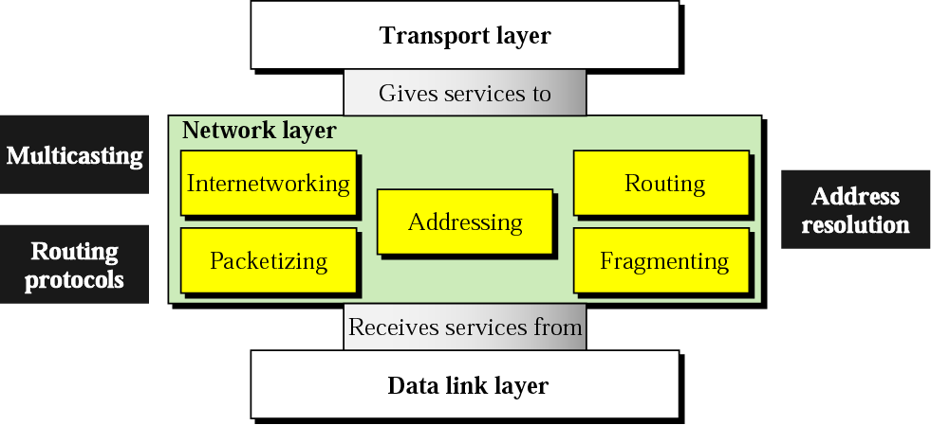
Function of Network Layer

Slide 4
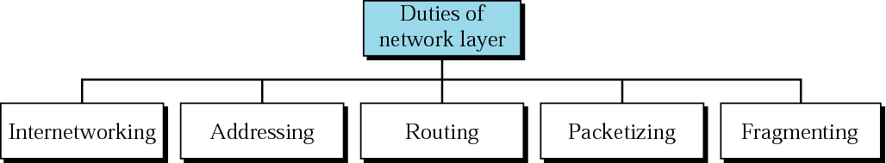
Network layer duties
The key is interconnecting different networks (various LAN technologies, telephone network, satellite link, ATM networks etc.) and making them look the same to the upper layer; i.e. logical gluing of heterogeneous physical networks together to look like a single network to the Transport & Application layer.
Additional notes: The transport layer should not be worried about the underlying physical network !

Slide 5

Network layer duties
The addresses must be uniquely and universally define the sole connection of a (host/router/machine/device/user) to the internet. Two devices on the internet can never have the same address. (Address per connection)
Remember, network layer is independent of the data link layer.
We cannot use the data link layer addresses !! Because these addresses depend on the technology used in the data link layer.

Slide 6
Network layer duties
Network layer encapsulates packets received from upper layer protocols and makes new packets. (Re-packaging).
This is a task common to all layers.
In the Internet model, packetizing is done by network layer protocol called IP – Internetworking Protocol.
The Protocol Data Units (PDU’s) coming from the transport layer must be placed in network-layer packets and sent to the data-link layer.

Slide 7
Network layer duties
A packet can travel through different networks. Each router decapsulates the IP datagram from the received frame, processes it and then encapsulates it in another frame. The format & size depend on the physical network.
Remember, the network layer must be able to operate on top of any data-link layer technology (Ethernet, Fast Ethernet, ATM etc.). All these technologies can handle a different packet length.
The network layer must be able to fragment transport layer PDUs into smaller units so that they can be transferred over various data-link layer technologies.

Slide 8
Network layer duties
Now that you have your network layer packet, where do you send it ? Each packet reaches its destination via several routes.
So, which route is suitable or optimum? Issue of speed, reliability, security etc. (routing algorithm)
Packet cannot choose the route; the routers connecting the LANs/WANs makes this decision.
*

Slide 9
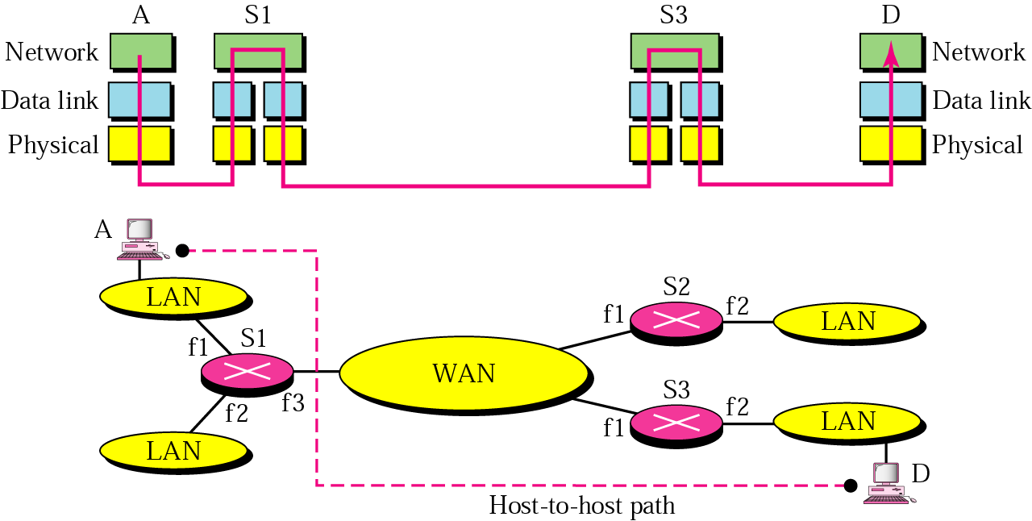
Internetworking
How can data be exchanged between networks?
They need to be connected via routers/links to make an internetwork.
The above internetwork is made of 5 networks: 4 LANs and 1 WAN.
E.g. If host A needs to send a data packet to host D, the packet needs to go from A to S1, then from S1 to S3, and finally from S3 to D. Therefore the packet passes through 3 links.
*

Slide 10
Internetworks
MAC layer protocol
link-1 link-2 link-3
Problem: how does S1 know that they should send out from f3 after packet arrive at f1 from A? (No provision in data-link layer to help S1 making the decision and the frame only contains the MAC addresses-pair of 1st link)
To solve the problem of delivery thru several links, the network layer was designed and responsible for host-to-host delivery and for routing the packets thru different routers.

Slide 11
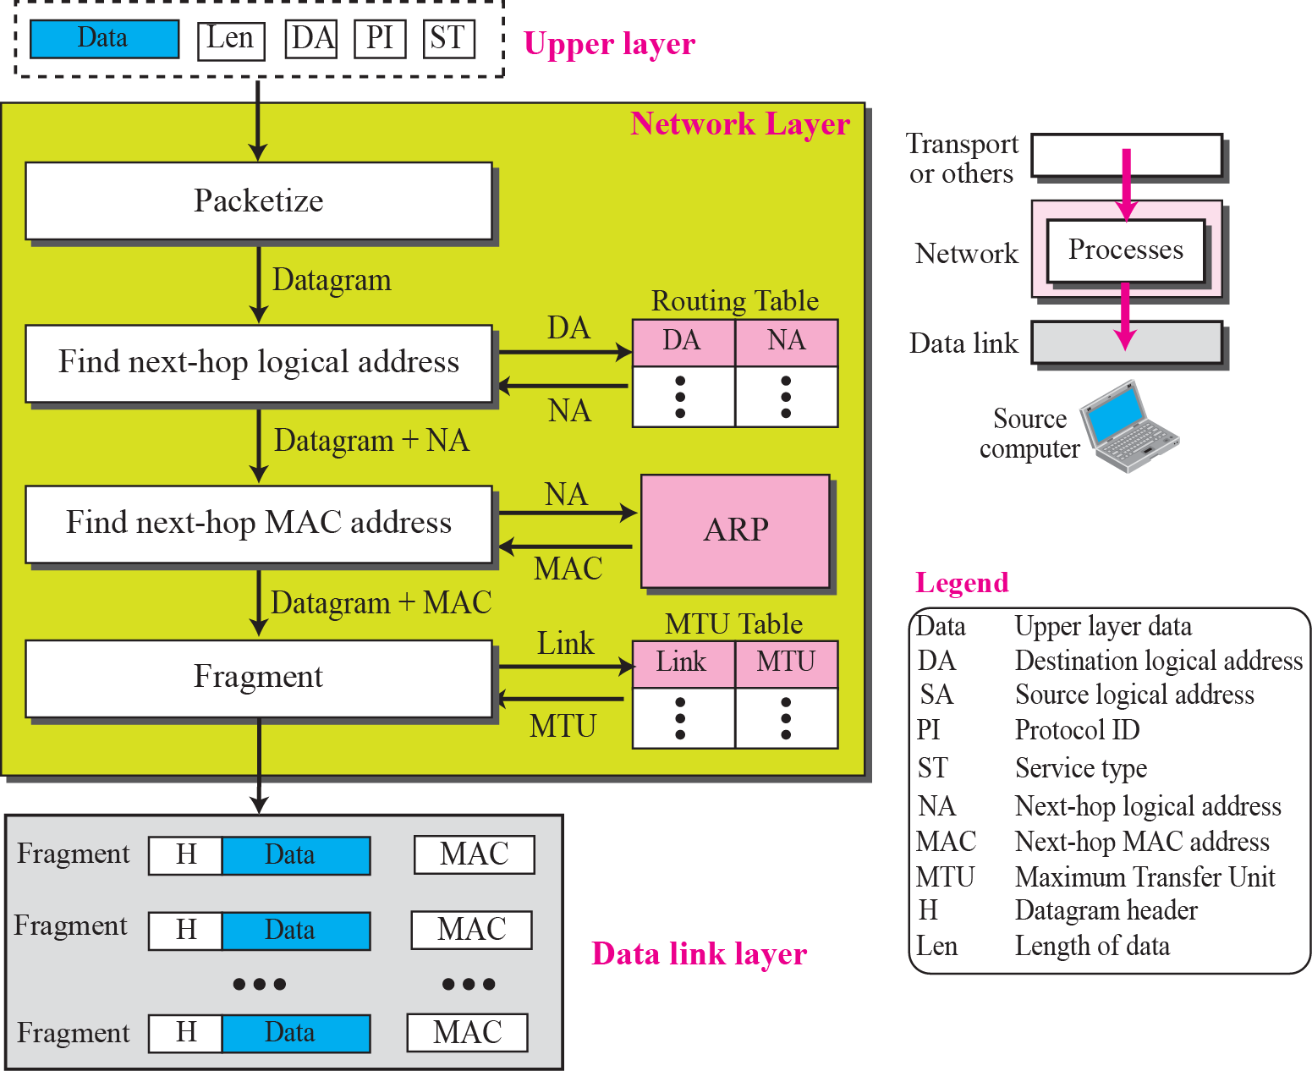
Network layer at the Source
Packetizing
  Encapsulate the data coming from the upper layer in a datagram
Finding Logical Address of Next Hop
  Consult a routing table to find the logical address of the next hop
Finding MAC Address of Next Hop
  Using ARP(Address Resolution Protocol)
Fragmentation
  When the datagram is bigger then MTU(Maximum Transmission Unit) datagram needs to be fragmented to smaller units before being passed to the data link layer

Slide 12
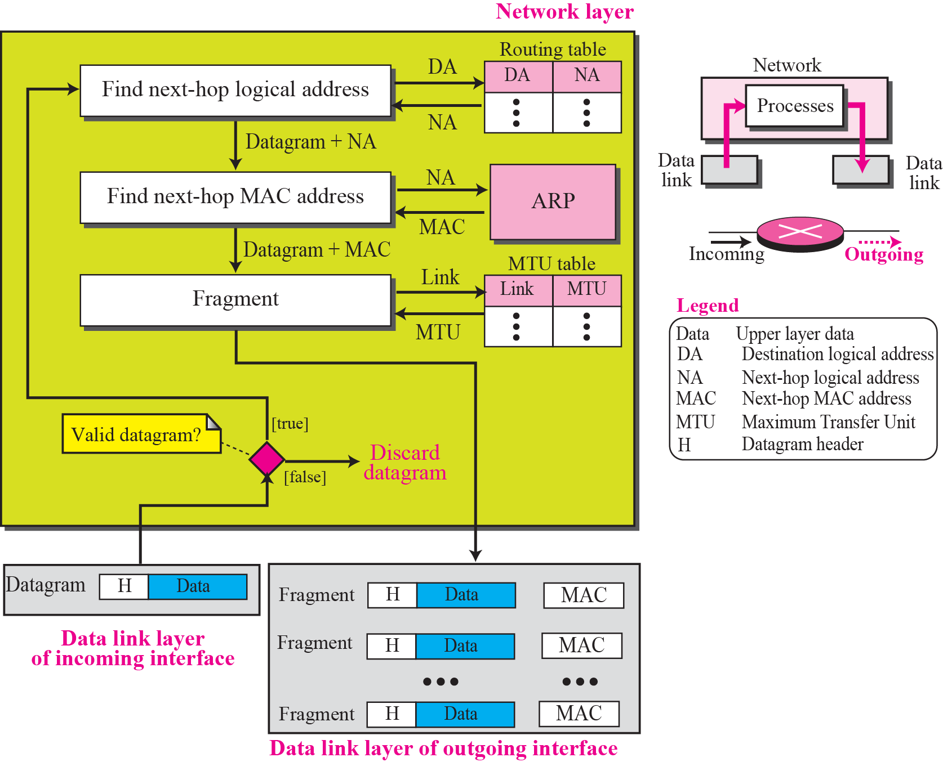
Network layer at the Router
A router is involved with two interface (the incoming interface and the outgoing interface)
Finding next-hop logical address
Finding next-hop MAC address
Fragmentation

Slide 13
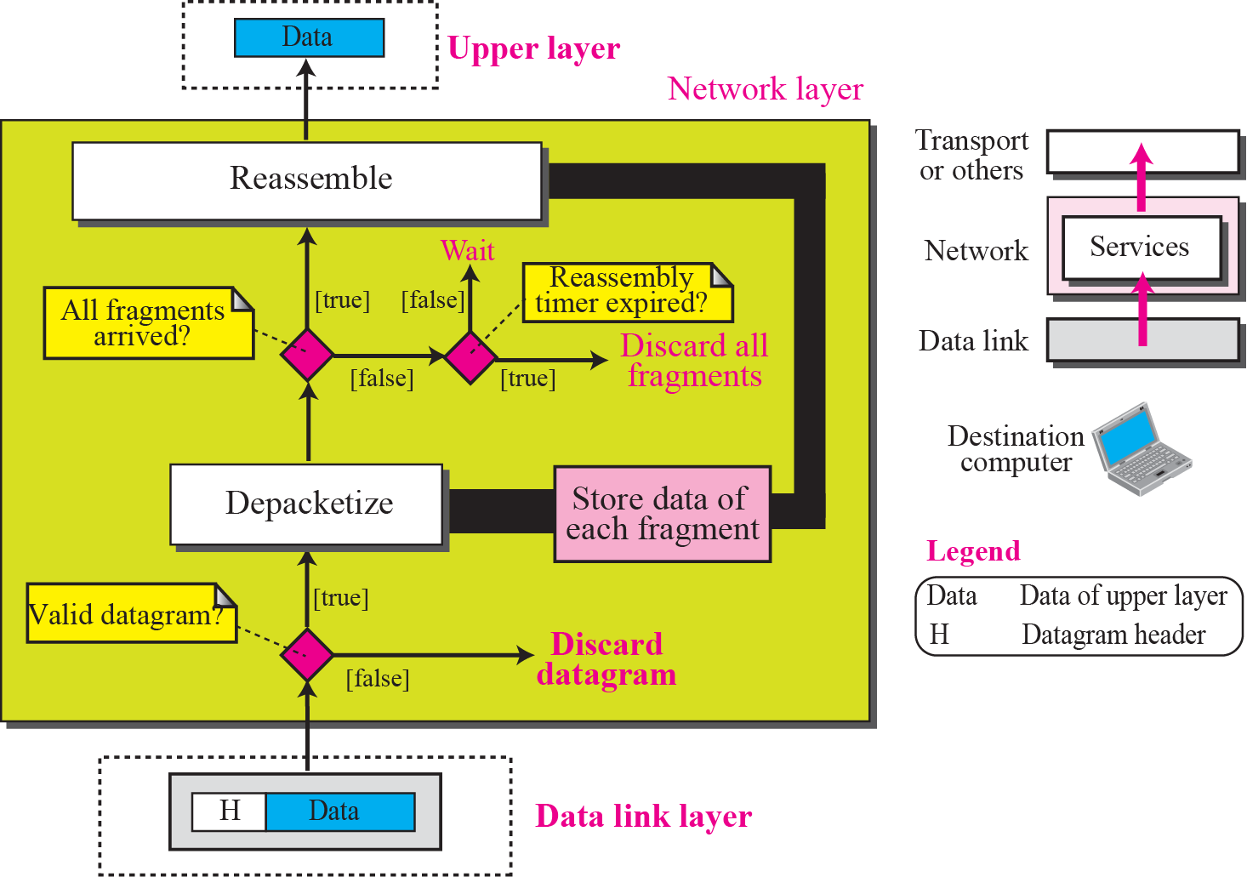
Network layer at the Destination
Reassemble the fragment (Validating each datagram)
Deliver the data to upper layer
Set a reassembly timer, if the timer is expired, all data fragments are destroyed and an error message is sent that all the fragmented datagram need to be resent

Slide 14
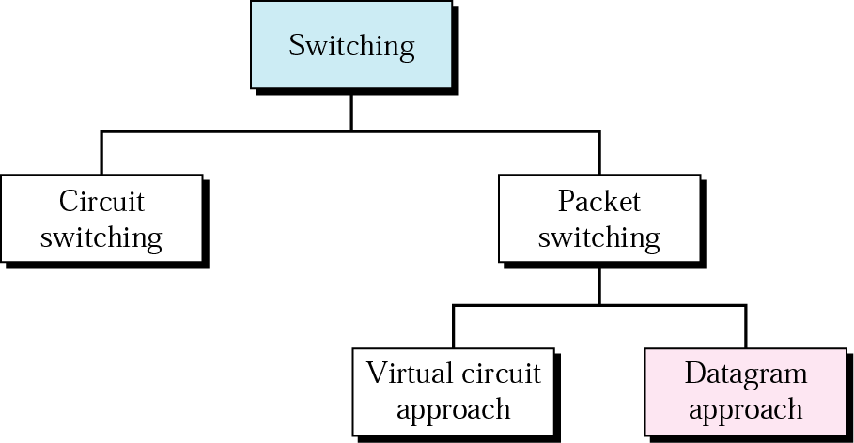
Switching/Routing Mechanism
Used in computer networks and (also in modern telephone networks).
Packets of bits (not lines) are switched!
Used in telephone networks for more than 100 years. A physical link is dedicated between Source and Destination. Data can be sent as a stream of bits without the need for packetising
(Also called Connection-oriented networking)
(Also called Connectionless networking)

Slide 15
Basic Operation
Data transmitted in small packets
  Longer messages split into series of packets
  The size of the packet is determined by the network and the governing protocol
  Each packet contains a portion of user data plus some control info
Control info
  Routing (addressing) info
Packets are received, stored briefly (buffered) and past on to the next node
  Store and forward

Slide 16
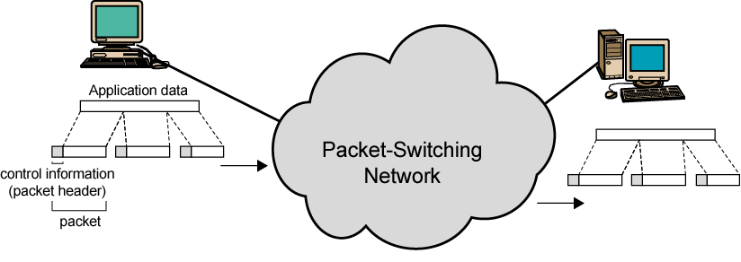
Use of Packets
In a packet-switched network, there
is no resource reservation;
resources are allocated on demand.

Slide 17
Advantages : Packet Switching
Line efficiency
  Single node to node link can be shared by many packets over time
  Packets queued and transmitted as fast as possible
Data rate conversion
  Each station connects to the local node at its own speed
  Nodes buffer data if required to equalize rates
Packets are accepted even when network is busy
  Delivery may slow down
Priorities can be used

Slide 18
Packet Switching Technique
A station breaks long message into packets
Packets are sent out to the network sequentially, one at a time
How will the network handle this stream of packets as it attempts to route them through the network and deliver them to the intended destination?
  Two approaches
    Datagram approach
    Virtual circuit approach

Slide 19
Datagram
Each packet is treated independently, with no reference to packets that have gone before.
  Each node chooses the next node on a packet’s path.
Packets can take any possible route based on the link availability.
Packets may arrive at the receiver out of order.
Packets may go missing due to lack of resources (upper layers ask for retransmission).
It is up to the receiver to re-order packets and recover from missing packets.
Connectionless networks (switch does not keep information about connection state)
Example: Internet

Slide 20

Datagram

Slide 21
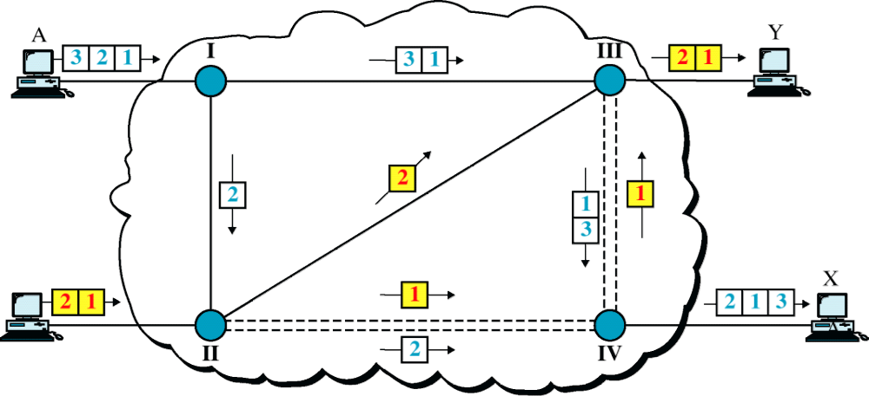

Datagram Approach, Multiple Channels

Slide 22

Routing table in a datagram network
Each switch has a routing table which is based on the destination address
Routing tables are dynamic and update periodically
Destination address and corresponding forwarding output ports are recorded in the table

Slide 23
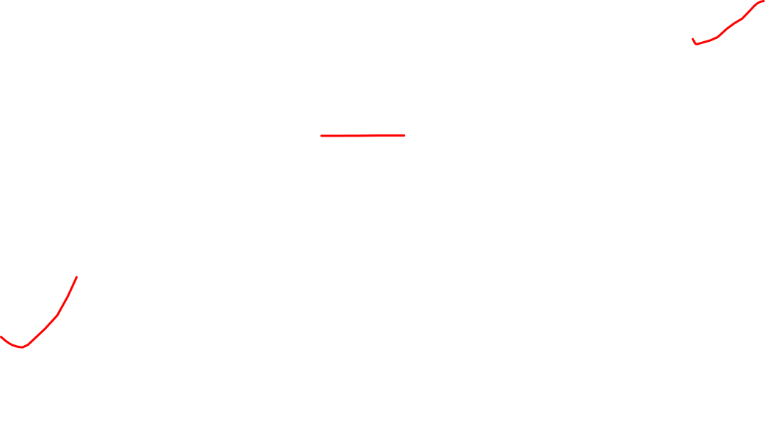
Routing table in a datagram network
A switch in a datagram network uses a routing table that is based on the destination address.
The destination address in the header of a packet in a datagram network remains the same during the entire journey of the packet.
Efficiency is better than a circuit switched network (channel is always occupied)

Slide 24

Delay in a datagram network
Delay is greater than a circuit switching and VCN
Total delay = 3T + 3τ + w1 + w2

Slide 25
Virtual Circuit
Hybrid version of Circuit and datagram network
  Data is transmitted as packets
  All packets from one packet stream are sent along a pre-established path (i.e., a virtual circuit)
No capacity guarantees, but guarantees no reordering of packets

Slide 26
Virtual Circuit
In virtual circuit, a preplanned route is established before any packets are sent, then all packets follow the same route.
Each packet contains a virtual circuit identifier instead of destination address, and each node on the pre-established route knows where to forward such packets.
  The node need not make a routing decision for each packet.
  implemented in data link layer
Example: X.25, Frame Relay, ATM

Slide 27

Virtual Circuit
A route between stations is set up prior to data transfer.
All the data packets then follow the same route.
But there is no dedicated resources reserved for the virtual circuit! Packets need to be stored-and-forwarded.

Slide 28

Virtual Circuit identifier
Addressing:
Global Addressing
Virtual circuit identifier

Slide 29

Switch and tables in a virtual-circuit
network

Slide 30

Source-to-destination data transfer in a
virtual-circuit network

Slide 31

Setup request in a virtual-circuit network

Slide 32

Setup ACKNOWLDGEMENT in a virtual-circuit
\network

Slide 33
In virtual-circuit switching, all packets belonging to the same source and destination travel the same path; but the packets may arrive at the destination with different delays if resource allocation is on demand.

Slide 34

Delay in a virtual-circuit network
delay_tot = delay_trans+ delay_prop+setup delay+ teardowndelay

Slide 35
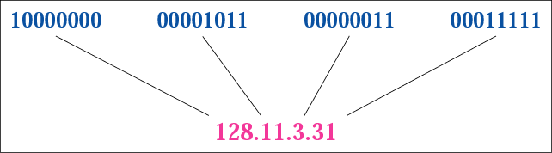
Relationship of Binary & Dotted-decimal notation

Slide 36
Example
Change the following IP address from binary notation to dotted-decimal notation.
10000001 00001011 00001011 11101111
Solution
129.11.11.239
*

Slide 37
Example
Change the following IP address from dotted-decimal notation to binary notation.
111.56.45.78
Solution
01101111 00111000 00101101 01001110
*

Slide 38
IP-Addressing
The general identifier used in network layer to identify each device connected to the Internet is called the Internet address or IP address.
Two types ID: Network Address & Host Address.
In IPv4, an IP address is a 32-bit binary address (4-bytes) that uniquely and universally defines the connection of a host or a router to the Internet. (Universal in the sense that the addressing system must be accepted by any host that wants to be connected to Internet).
Each IP address is unique and only defines 1 connection to the Internet. Two devices on the internet can never have the same address at the same time. (referring to IP Public addresses).
*

Slide 39
IP-Addressing
Two types of IP addressing: Classful vs. Classless
When a packet needs to be sent from s host to destination, it needs to pass from one node to the next. The network layer provides only host-to-host addressing; the data-link layer needs physical MAC addresses for node-to-node delivery.
Method to map these two addresses: ARP – Address Resolution Protocol.
*

Slide 40
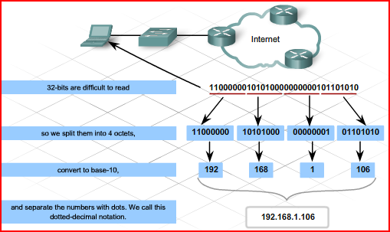
*

Slide 41
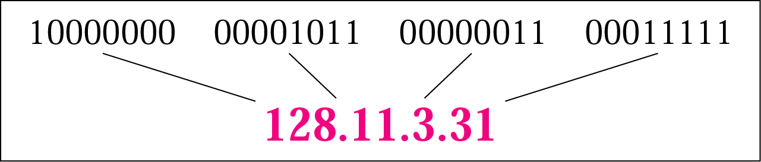
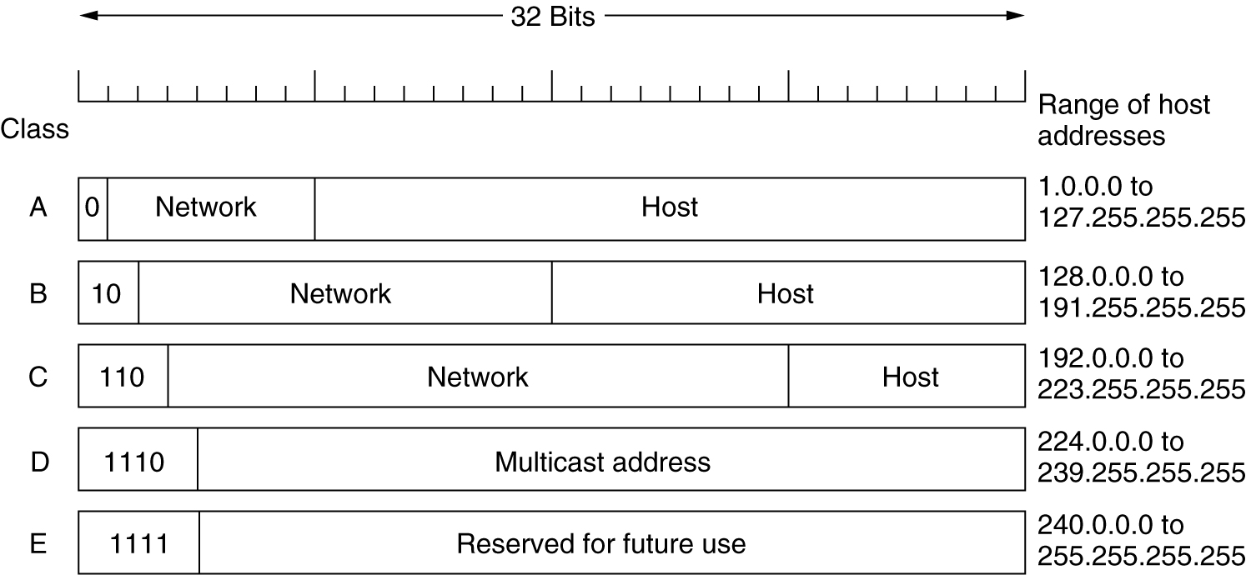
IP Addresses
Unicast
Multi-cast
*

Slide 42

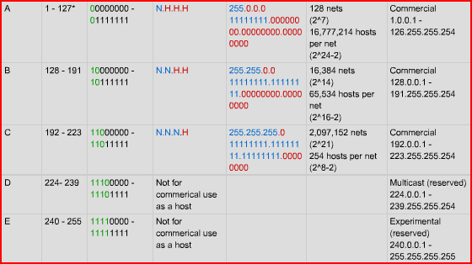
*

Slide 43
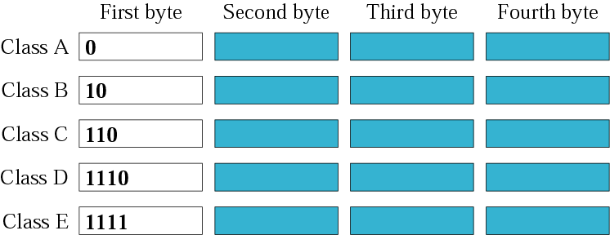
Classful Addressing:
Finding the class in binary notation
*

Slide 44

Classful Addressing:
Finding the class in decimal notation
*

Slide 45
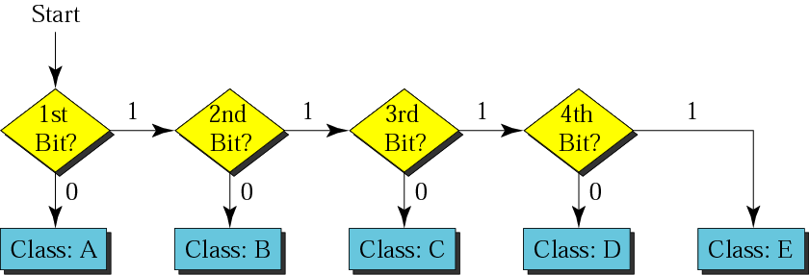
Finding the address class
*

Slide 46
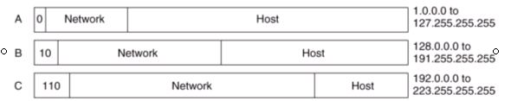
Classful Addresses
Classful addressing in IP is both inflexible and inefficient !
0.0.0.0 to 127.255.255.255
128.0.0.0 to 191.255.255.255
192.0.0.0 to 223.255.255.255
allows 127 networks and 16 777 214 hosts on each network
7 bits = 2⁷ -1: exclude 0.0.0.0
24 bits = 2²⁴ -2: exclude 1st and last IP
allows 16384 networks and 65534 hosts on each network
14 bits = 2¹⁴
16 bits = 2¹⁶ -2: exclude 1st and last IP
allows 2 097 152 networks and 254 hosts on each network
21 bits = 2²¹
8 bits = 2⁸ -2: exclude 1st and last IP
Note: In each network, the 1st IP address is the Network Address (e.g. 73.0.0.0) and the last IP address is for special purpose (e.g. 73.255.255.255) .
*

Slide 47
Classful Addressing
Unicast address: one source to one destination; Class A, B & C.
Multicast address: one source to a group of destination: only as destination address not source address; Class-D.
IP addresses in class A, B, C are divided into different length of:
    Network-ID (netid) and Host-ID (hostid)
Classes and Blocks concept: - for example:
In class-A, 1st block covers from 0.0.0.0 to 0.255.255.255 (net-ID 0)
2nd block covers from 1.0.0.0 to 1.255.255.255 (net-ID 1)
last block covers from 127.0.0.0 to 127.255.255.255 (net-ID 127)
Note that: block = number of available networks in each class
One problem with classful addressing is that each class is divided into a fixed number of blocks with fixed size. (read Forouzan’s text)
Plenty of IP addresses wasted!!! in classful addressing method.
*

Slide 48
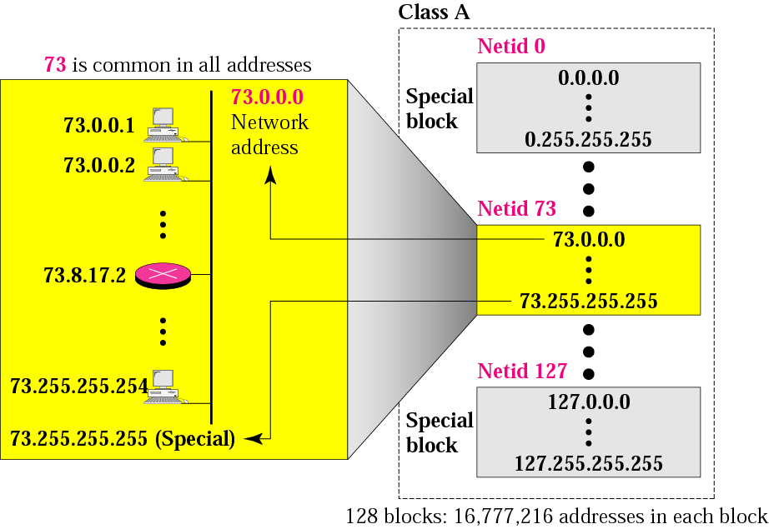
128 Blocks in class A
1st IP used to identify organisation to the rest of Internet
3 bytes = 2²⁴
Last IP reserved for special purpose; not allowed to use
*
Millions of class A addresses are wasted.

Slide 49
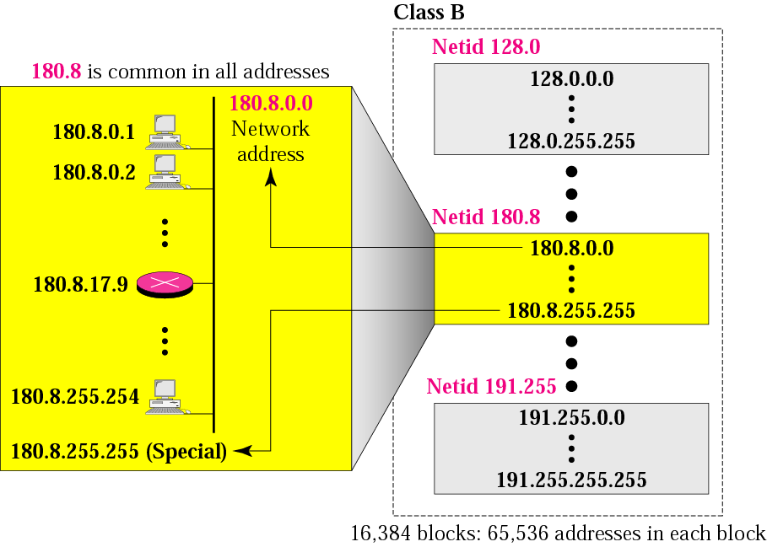
16384 Blocks in class B
16 blocks for private addressees leaving 16368 blocks
Class B for midsize organisation. 16384 organizations are class-B
*
Many of class B addresses are wasted.

Slide 50
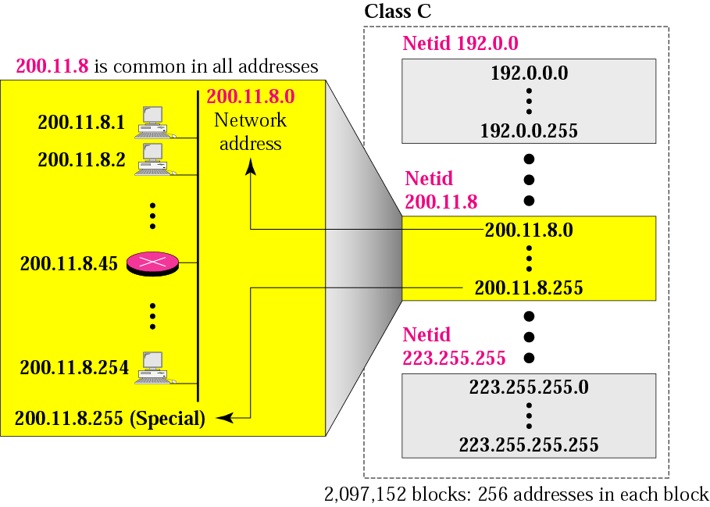
2,097,152 Blocks in class C
256 blocks for private addressees leaving 2,096,896 blocks
Class C for small organisation. Limited IP address in each blocks, which is smaller than the needs of most organisations
*

Slide 51
Class D addresses
are used for multicasting;
there is only
one block in this class.
Class E addresses are reserved
for special purposes;
most of the block is wasted.
*

Slide 52
Network Addresses
The network address is the first address.
The network address defines the network to the rest of the Internet.
Given the network address, we can find the class of the address, the block, and the range of the addresses in the block
*

Slide 53
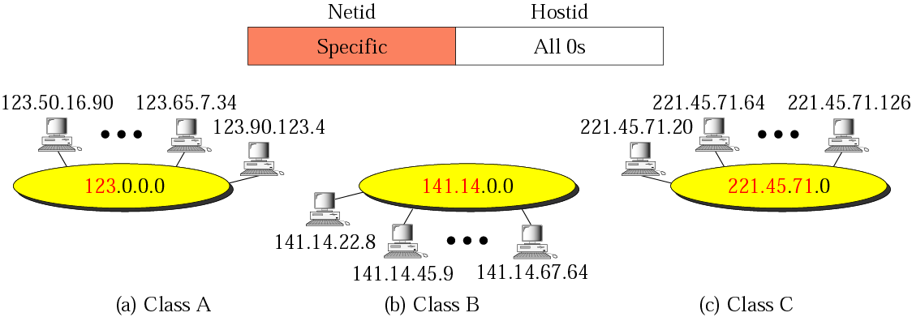
Figure 4-13
Network addresses
In classful addressing, the network address
(the first address in the block)
is the one that is assigned to the organization.
*

Slide 54
Example
Given the network address 17.0.0.0, find the class, the block, and the range of the addresses.
Solution
The class is A because the first byte is between 0 and 127.
The block has a netid of 17.
The addresses range from 17.0.0.0 to 17.255.255.255.
*

Slide 55
Example
Given the network address 132.21.0.0, find the class, the block, and the range of the addresses.
Solution
The class is B because the first byte is between 128 and 191.
The block has a netid of 132.21.
The addresses range: 132.21.0.0 to 132.21.255.255.
*

Slide 56
Example
Given the network address 220.34.76.0, find the class, the block, and the range of the addresses.
Solution
The class is C because the first byte is between 192 and 223. The block has a netid of 220.34.76.
The addresses range from 220.34.76.0 to 220.34.76.255.
*

Slide 57
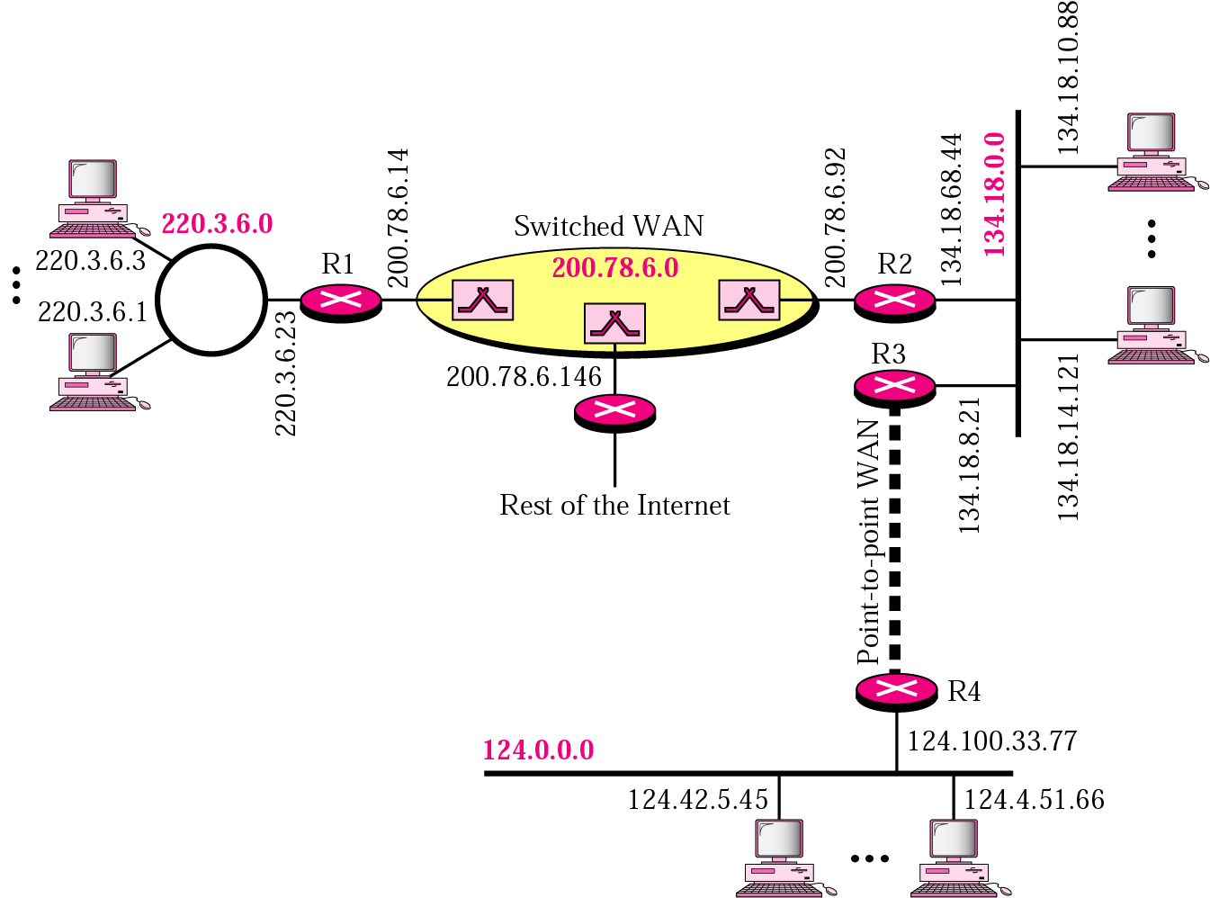
Sample Internet
Note: When it comes to routing, the outside world recognises the network via network address, not the individual host-IPs
*

Slide 58
Network Addresses
The network address is the
beginning address of each block.
It can be found by applying the default mask to any of the IP addresses in the block.
It retains the netid of the block
and sets the hostid to zero.
We must not apply the default mask
of one class to an address belonging
to another class.
*

Slide 59
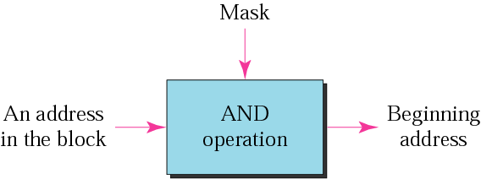
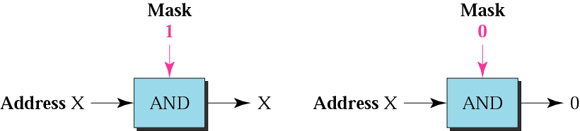
Mask
A mask is a 32-bit binary number or 4-bytes that gives the first address in the block (the network address) when bitwise ANDed with an address in the block.
*

Slide 60
Default Mask
Default class A mask is 255.0.0.0
Default class B mask is 255.255.0.0
Default class C mask is 255.255.255.0
*

Slide 61
Example
Given the address 23.56.7.91 and the default class A mask, find the beginning address (network address).
Solution
The default mask is 255.0.0.0, which means
that only the first byte is preserved
and the other 3 bytes are set to 0s.
The network address is 23.0.0.0.
*

Slide 62
Example
Given the address 132.6.17.85 and the default class B mask, find network address.
Solution
The default mask is 255.255.0.0, which means
that the first 2 bytes are preserved
and the other 2 bytes are set to 0s.
The network address is 132.6.0.0.
*

Slide 63
Example
Given the address 201.180.56.5 and the class C default mask, find the network address.
Solution
The default mask is 255.255.255.0,
which means that the first 3 bytes are
preserved and the last byte is set to 0.
The network address is 201.180.56.0.
*

Slide 64
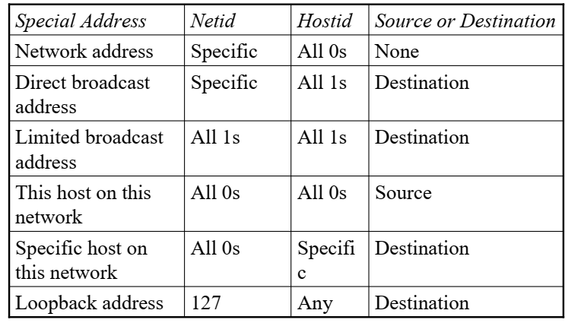
Special Addresses

Slide 65
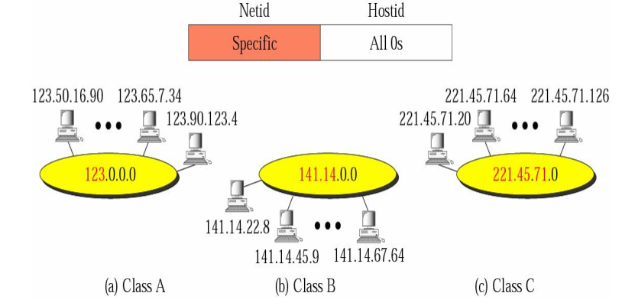
Special Addresses
Network Addresses

Slide 66
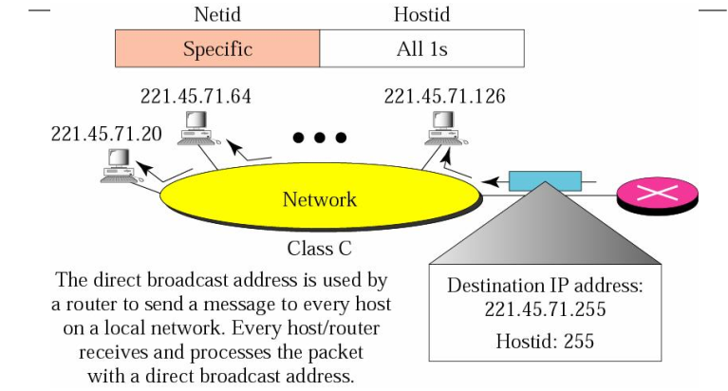
Special Addresses
Direct Broadcast Address

Slide 67
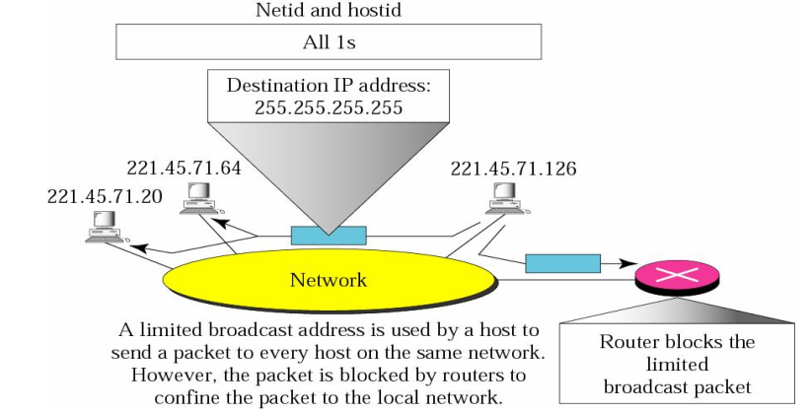
Special Addresses
Limited Broadcast Address

Slide 68
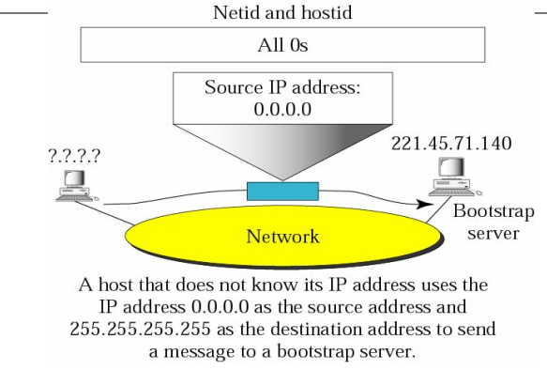
Special Addresses
Host on this network

Slide 69
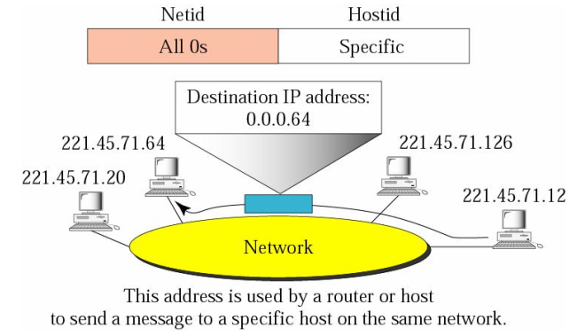
Special Addresses
Specific host on this network

Slide 70
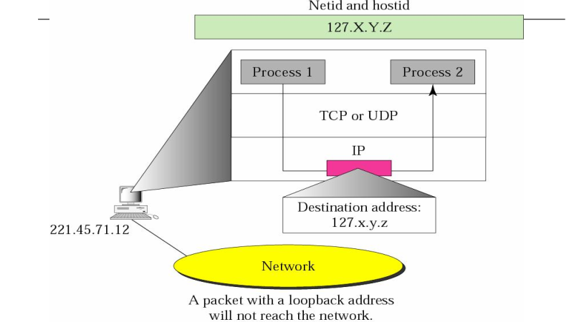
Special Addresses
Loopback Address

Slide 71
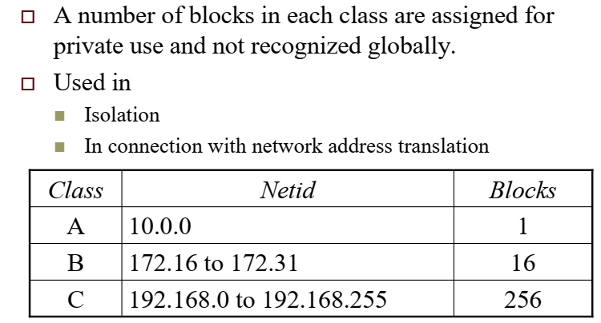
Private Addresses

Slide 72
IP-Addressing/Subnetting
IP address designed with 2 levels of hierarchy: network-ID & host-ID.
However, often organisation needs to assemble the hosts into groups: the network needs to be divided into several subnetworks (subnets); hence requires 3 levels of hierarchy. (netid: subnetid : hostid)
The outside world only knows the organisation by its network address. Inside the organisation each sub-network is recognised by its sub-network address.
In subnetting, a network is divided into several smaller groups that have its own subnet address depends on the hierarchy of subnetting but still appear as a single network to the rest of the Internet.
The question is how a router knows whether it is a network address or a subnet? The key is using the subnet mask. (similar to def. mask).
Only the network administrator knows about the network address and subnet address but router does not. External router has routing table based on network addresses; Internal router has routing table based on subnetwork addresses.
*

Slide 73
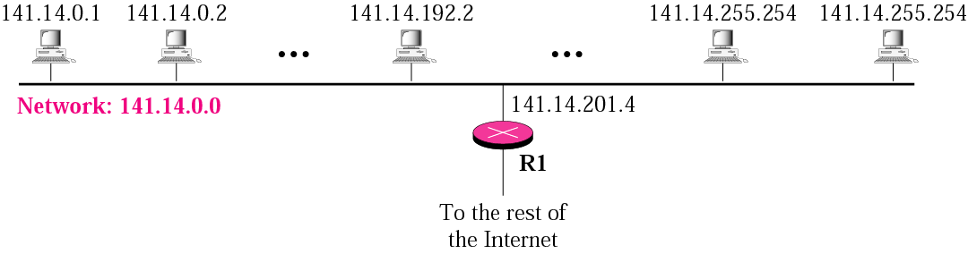
A network with two levels of
hierarchy (not subnetted)
*

Slide 74
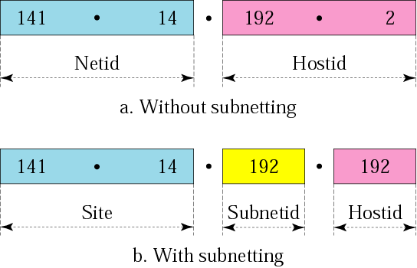

Addresses in a network
With and without subnetting
Just like telephone system
*

Slide 75
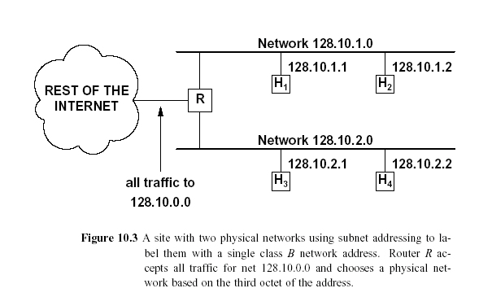
Network Addresses/subnetting
2 Subnetworks
Network Address
*

Slide 76
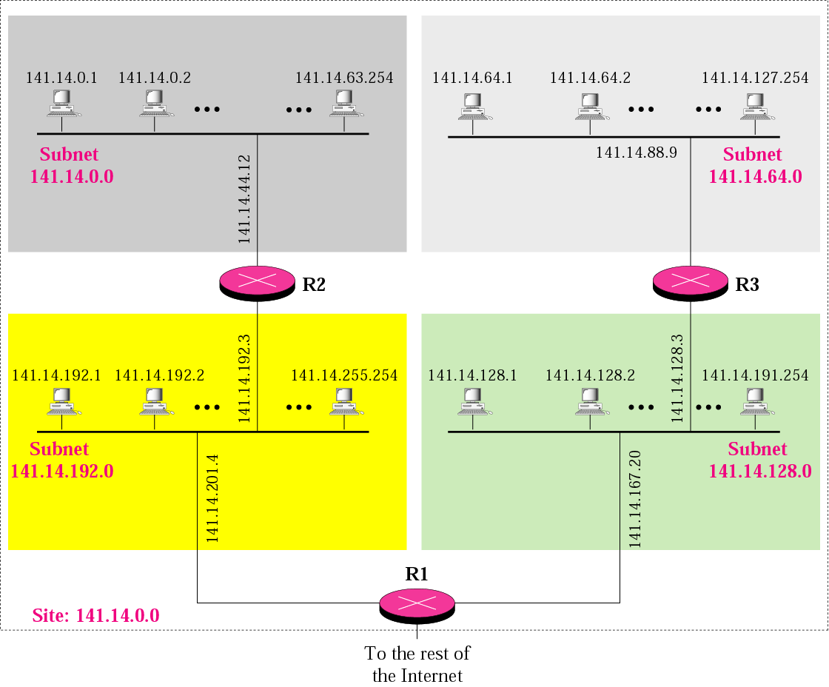
A network with three levels of
hierarchy (subnetted)
Internal routers
External router
*

Slide 77
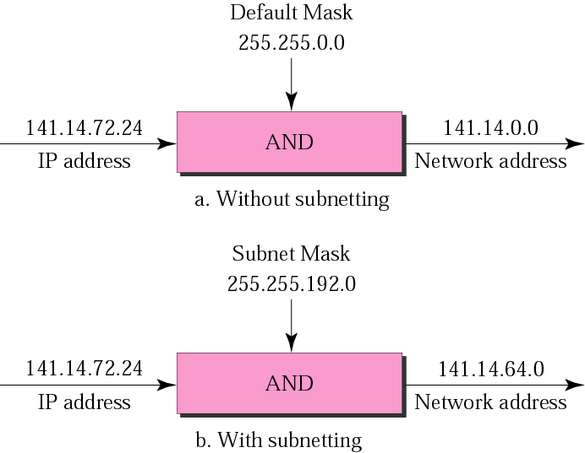
Default mask and subnet mask
*

Slide 78
Finding the Subnet Address
Given an IP address, we can find the subnet address the same way we found the network address in the previous chapter.
We apply the mask to the address.
We can do this in two ways: straight or short-cut.
*

Slide 79
Straight Method
In the straight method, we use binary notation for both the address and the mask and then apply the AND operation to find the subnet address.
Short-Cut Method
** If the byte in the mask is 255, copy the byte in the address.
** If the byte in the mask is 0, replace the byte in the address with 0.
** If the byte in the mask is neither 255 nor 0, we write the mask and the address in binary and apply the AND operation.
*

Slide 80
Example
What is the sub-network address if the destination address is 200.45.34.56 given that the subnet mask is 255.255.240.0?
Solution
11001000 00101101 00100010 00111000
11111111 11111111 11110000 00000000
11001000 00101101 00100000 00000000
The subnetwork address is 200.45.32.0.
*

Slide 81
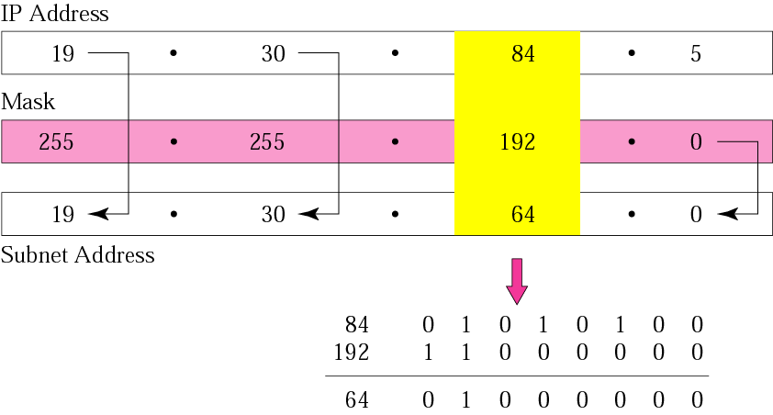
Example
What is the sub-network address if the destination address is 19.30.80.5 and the mask is 255.255.192.0?
Solution
Answer: Subnet Address = 19.30.64.0
*

Slide 82
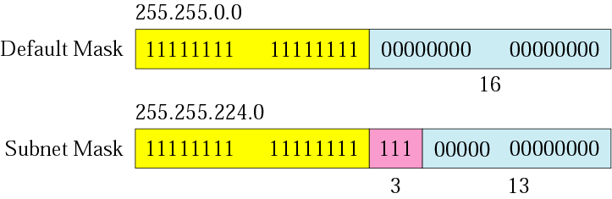

Comparison of a default mask and
a subnet mask
The number of subnets must be
a power of 2.
*

Slide 83
Example
A company is granted the site address 201.70.64.0 (class C). The company needs six subnets. Design the subnets.
Solution
The number of 1s in the default mask is 24 (class C).
The company needs six subnets. Since 6 is not a power of 2, the next number that is a power of 2 is 8 (2³). That means up to 8 subnets.
Hence, we need 3 more ‘1’s in the subnet mask = 11111111.11111111.11111111.11100000 or 255.255.255.224
The total number of 1s in the subnet mask is 27 (24 + 3).
Since the total number of 0s is 5 (32 - 27).
    The number of addresses in each subnet is 2⁵ (5 is the number of 0s) or 32.
*

Slide 84
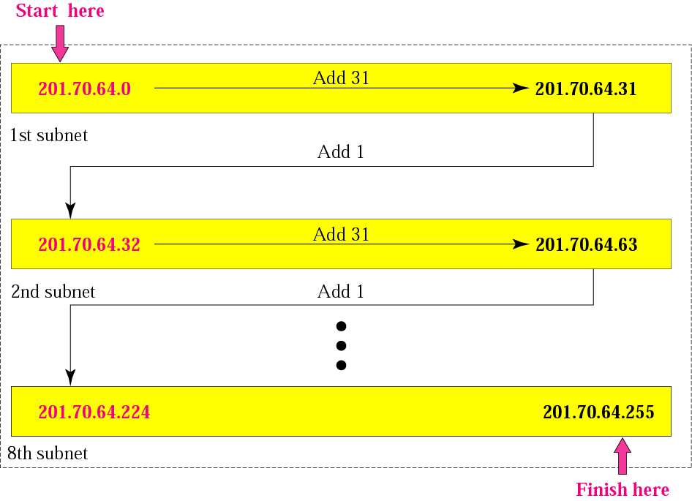
*

Slide 85
Example
A company is granted the site address 181.56.0.0 (class B). The company needs 1000 subnets. Design the subnets.
Solution
The number of 1s in the default mask is 16 (class B).
The company needs 1000 subnets. Since it is not a power of 2, the next number is 1024 (2¹⁰). We need 10 more 1s in the subnet mask.
The total number of 1s in the subnet mask is 26 (16 + 10).
The total number of 0s is 6 (32 − 26).
*

Slide 86
Solution (Continued)
The submask is
11111111 11111111 11111111 11000000
or
255.255.255.192.
The number of subnets is 1024.
The number of addresses in each subnet is 2⁶ (6 is the number of 0s) or 64.
*

Slide 87
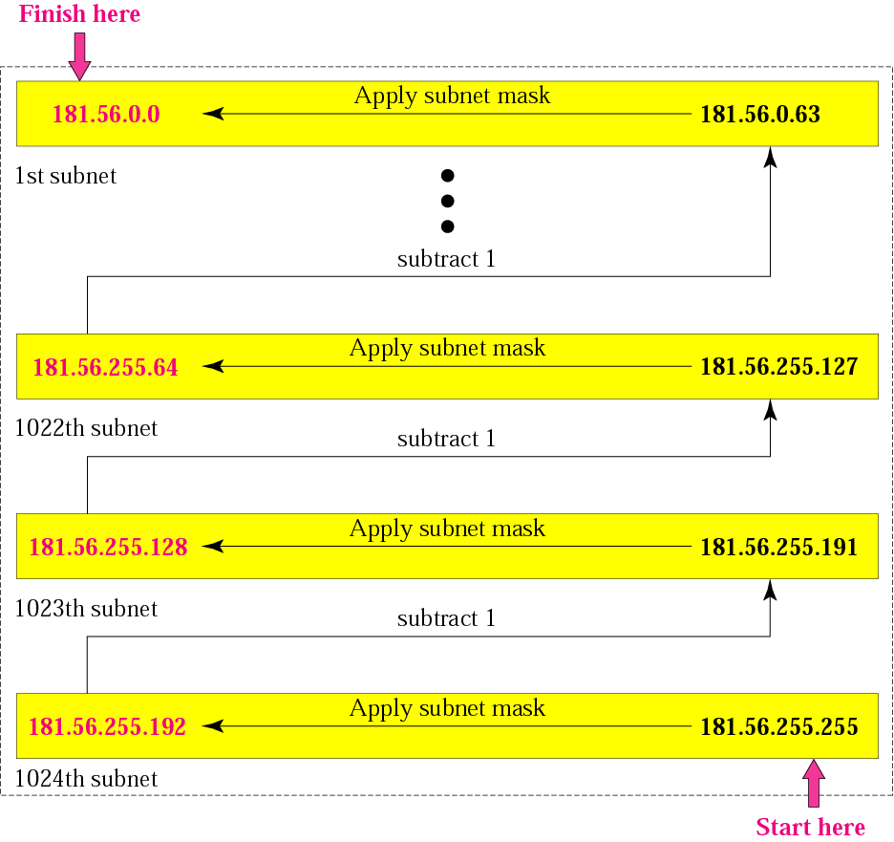
Example
*

Slide 88
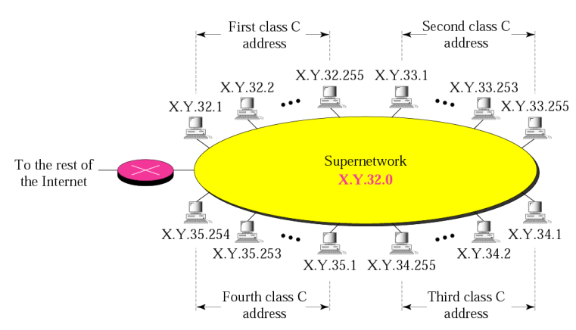
Super-network
In supernetting, organization can combine several class C blocks to create larger range of addresses.

Slide 89
Super-network Rules
Rule for creating supernetwork block,
  The number of blocks must be a power of 2 (1,
  2, 4, 8, 16, . . .).
  The blocks must be contiguous in the address
  space (no gaps between the blocks).
  The third byte of the first address in the superblock must be evenly divisible by the number of blocks. In other words, if the number of blocks is N, the third byte must be divisible by N.

Slide 90
Example
A company needs 600 addresses. Which of the following set of class C blocks can be used to form a supernet for this company?
198.47.32.0 198.47.33.0 198.47.34.0
198.47.32.0 198.47.42.0 198.47.52.0 198.47.62.0
198.47.31.0 198.47.32.0 198.47.33.0 198.47.52.0
198.47.32.0 198.47.33.0 198.47.34.0 198.47.35.0
Solution:
1: No, there are only three blocks.
2: No, the blocks are not contiguous.
3: No, 31 in the first block is not divisible by 4.
4: Yes, all three requirements are fulfilled.

Slide 91
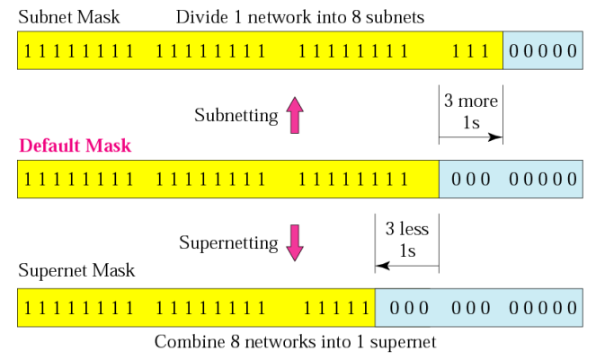
Comparison of subnet, default,
and supernet masks

Slide 92
Example
We need to make a supernetwork out of 16 class C blocks. What is the supernet mask?
Solution:
We need 16 blocks. For 16 blocks we need to change four 1s to 0s in the default mask. So the mask is
11111111 11111111 11110000 00000000
or
255.255.240.0

Slide 93
Example
A supernet has a first address of 205.16.32.0 and a supernet mask of 255.255.248.0. A router receives three packets with the following destination addresses:
205.16.37.44
205.16.42.56
205.17.33.76
Which packet belongs to the supernet?
Solution:
We apply the supernet mask to see if we can find the beginning address.
205.16.37.44 AND 255.255.248.0 => 205.16.32.0
205.16.42.56 AND 255.255.248.0 => 205.16.40.0
205.17.33.76 AND 255.255.248.0 => 205.17.32.0
Only the first address belongs to this supernet.

Slide 94
Example
A supernet has a first address of 205.16.32.0 and a
supernet mask of 255.255.248.0. How many blocks are in this supernet and what is the range of addresses?
Solution:
The supernet has 21 1s. The default mask has 24 1s. Since the difference is 3, there are 2³ or 8 blocks in this supernet. The blocks are 205.16.32.0 to 205.16.39.0. The first address is 205.16.32.0. The last address is 205.16.39.255.

Slide 95
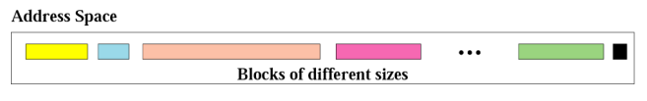
Classless Addressing
The whole idea of classeless addressing is to have variable length blocks that belongs to no class.
Whole 2³² address space is divided into different size blocks.
There is only one condition on the number of addresses in a block; it must be a power of 2 (2, 4, 8, . . .).
A household may be given a block of 2 addresses. A small business may be given 16 addresses. A large
organization may be given 1024 addresses.

Slide 96
Classless Addressing
The beginning address must be evenly divisible by the number of addresses.
  For example, if a block contains 4 addresses, the beginning address must be divisible by 4.
  If the block has less than 256 addresses, we need to check only the rightmost byte. If it has less than 65,536 addresses, we need to check only the two rightmost bytes, and so on.
Example: Which of the following can be the beginning address of a block that contains 16 addresses? 205.16.37.32, 190.16.42.44
17.17.33.80, 123.45.24.52
Solution: The address 205.16.37.32 is eligible because 32 is
divisible by 16. The address 17.17.33.80 is eligible because 80 is divisible by 16.

Slide 97
Example
Which of the following can be the beginning address of a
block that contains 1024 addresses?
205.16.37.32, 190.16.42.0, 17.17.32.0, 123.45.24.52
Solution:
To be divisible by 1024, the rightmost byte of an address should be 0 and the second rightmost byte must be divisible by 4. Only the address 17.17.32.0 meets this condition.

Slide 98

Slash notation
Writing a 4 byte mask is cumbersome process, instead of saying complete we define mask according to number of 1s in mask. We attach this number of one with slash notation to address.
Slash notation is also called CIDR (classless interdomain routing) notation.
For example: 205.16.37.24/29
Mask: 11111111.11111111.11111111.11111000 (255.255.255.248)

Slide 99
Slash notation
A block in classes A, B, and C can easily be represented in slash notation as A.B.C.D/ n where n is either 8 (class A), 16 (class B), or 24 (class C).
Example: A small organization is given a block with the beginning address and the prefix length 205.16.37.24/29 (in slash notation). What is the range of the block?
Solution: The beginning address is 205.16.37.24. To find the last address we keep the first 29 bits and change
the last 3 bits to 1s.
Beginning:11001111 00010000 00100101 00011000
Ending : 11001111 00010000 00100101 00011111
There are only 8 addresses in this block.

Slide 100
Example
What is the network address if one of the addresses is
167.199.170.82/27?
Solution:
The prefix length is 27, which means that we must keep the first 27 bits as is and change the remaining bits (5) to 0s. The 5 bits affect only the last byte.
The last byte is 01010010.
Changing the last 5 bits to 0s, we get 01000000 or 64.
The network address is 167.199.170.64/27.

Slide 101
Network Layer: Routing
Routing is a key function: determine a (best) path from any source to any destination
There exist multiple paths
Which path is best?
Depend on objective:
  Minimize number of hops
  Minimize end-to-end delay
  Maximize available bandwidth
Must have global knowledge about network state to perform this task
*

Slide 102
Criteria for a good Routing Algorithm
Correctness: correct route and accurate delivery of packets
Robustness: adaptive to changes of network topology for the case of link or node failure and varying traffic load
Cleverness: ability to detour congestion links and determine the connectivity of the network.
Efficiency: rapid finding of the route and minimization of control messages.

Slide 103
Classification of Routing Algorithms
Static vs. Dynamic:
  Static: manually pre-compute routes based on the topology and link capacity.
  Load the paths to the routing table and remain fixed for long time.
  simple, but not scalable and dynamic
  suitable for small and fixed topology n/w.
  Inability to react for n/w failures, traffic load changes and n/w size increases.
  Dynamic: automatic route computation, changes in n/w topology is propagated to all nodes, based on the information, node find the best paths.
  Adaptive to dynamics of network but add complication the node.

Slide 104
Routing tables
Path information is stored in routing table so that each node knows how to forward packets.
Store routing information, being looked up to forward packets
Different networks have different routing tables
  Datagram: destination address + next hop
  VC: incoming VCI + out-going VCI + out-going port number+ in-coming port number

Slide 105
Static Algorithms
(Non-Adaptive)
Shortest-path routing.
Flooding.
*

Slide 106
Flooding
No network info required
Packet sent by node to every neighbour.
Incoming packets retransmitted on every link except incoming link
Eventually a number of copies will arrive at destination
Each packet is uniquely numbered so duplicates can be discarded
Nodes can remember packets already forwarded to keep network load in bounds
Can include a hop count in packets
*

Slide 107
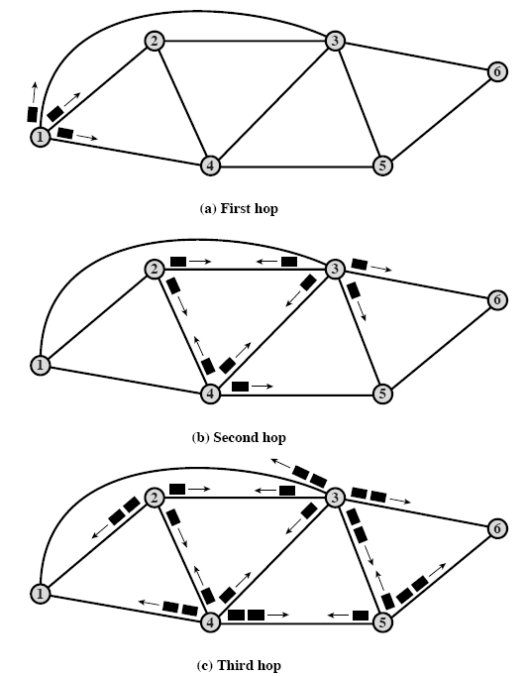
Flooding: Example
(hop-count=3)
*

Slide 108
Properties of Flooding
All possible routes are tried
  Very robust
At least one packet will have taken minimum hop count route
  Can be used to set up virtual circuit
All nodes are visited
  Useful to distribute information (e.g. routing)

Slide 109
Routing- Graph
Graph abstraction for routing algorithms:
graph nodes (vertices) are routers
graph links (edges) are physical links
  link cost: delay, $ cost, or congestion level
5
B
3
C
2
5
A
2
1
F
3
Routing protocol
1
2
D
E
Goal: determine “good” path
(sequence of routers) thru
network from source to dest.
1
“good” path:
  typically means minimum cost path
  other definitions possible

Slide 110
Shortest-Path Routing
Problem: Given a graph, where nodes represent routers and edges, links, find shortest path between a given pair of nodes.
What is shortest in shortest path?
  Depends on the routing metric in use.
  Example: number of hops (static), geographic distance (static), delay, bandwidth (raw versus available), combination of a subset of these.
Dijkstra’s shortest-path algorithm.

Slide 111
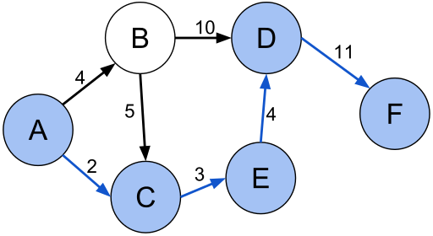
Shortest-Path Routing
ACEDF is the shortest path- distance=20, this is less than Dist(ABDF)=25, dist(ABCEDF)=27.

Slide 112
Dijkstra’s Shortest-Path Algorithm
Single-source shortest path problem
Initially, links (edges) are assigned costs.
As the algorithm executes, nodes are labeled with its distance to source along best known path.
Initially, no routes known, so all nodes are labeled with infinity.
Labels change as the algorithm proceeds.
Labels can be temporary or permanent.
  Initially all labels are tentative.
  A label becomes permanent if it represents the shortest path from the source to the node.

Slide 113
Dijkstra’s Shortest Path Algorithm
INPUT:
  Network topology (graph), with link costs
OUTPUT:
  Least cost paths from one node to all other nodes
  Produces “tree” of routes

Slide 114
Notation
c(i,j): link cost from node i to j; cost infinite if not direct neighbors; ≥ 0
D(v): current value of cost of path from source to destination v
p(v): predecessor node along path from source to v, that is next to v
S: set of nodes whose least cost path definitively known
5
B
3
C
2
5
A
2
1
F
3
1
2
D
E
1
Source
*

Slide 115

Dijsktra’s Algorithm
c(i,j): link cost from node i to j
D(v): current cost source → v
p(v): predecessor node along path from source to v, that is next to v
S: set of nodes whose least cost path definitively known
1 Initialization:
2 S = {A};
3 for all nodes v
4 if v adjacent to A
5 then D(v) = c(A,v);
6 else D(v) = ;
7
8 Loop
9 find w not in S such that D(w) is a minimum;
10 add w to S;
11 update D(v) for all v adjacent to w and not in S:
12 if D(w) + c(w,v) < D(v) then
// w gives us a shorter path to v than we’ve found so far
13 D(v) = D(w) + c(w,v); p(v) = w;
14 until all nodes in S;

Slide 116
Example: Dijkstra’s Algorithm
Step
0
1
2
3
4
5
start S
A
D(B),p(B)
2,A
D(C),p(C)
5,A
D(D),p(D)
1,A
D(E),p(E)
D(F),p(F)
5
1 Initialization:
2 S = {A};
3 for all nodes v
4 if v adjacent to A
5 then D(v) = c(A,v);
6 else D(v) = ;
…
B
3
C
2
5
A
2
1
F
3
1
2
D
E
1

Slide 117
Example: Dijkstra’s Algorithm
Step
0
1
2
3
4
5
start S
A
D(B),p(B)
2,A
D(C),p(C)
5,A
D(D),p(D)
1,A
D(E),p(E)
D(F),p(F)
…
8 Loop
9 find w not in S s.t. D(w) is a minimum;
10 add w to S;
update D(v) for all v adjacent
to w and not in S:
If D(w) + c(w,v) < D(v) then
D(v) = D(w) + c(w,v); p(v) = w;
14 until all nodes in S;
5
B
3
C
2
5
A
2
1
F
3
1
2
D
E
1
*

Slide 118
Example: Dijkstra’s Algorithm
Step
0
1
2
3
4
5
start S
A
AD
D(B),p(B)
2,A
D(C),p(C)
5,A
D(D),p(D)
1,A
D(E),p(E)
D(F),p(F)
…
8 Loop
9 find w not in S s.t. D(w) is a minimum;
10 add w to S;
update D(v) for all v adjacent
to w and not in S:
If D(w) + c(w,v) < D(v) then
D(v) = D(w) + c(w,v); p(v) = w;
14 until all nodes in S;
5
B
3
C
2
5
A
2
1
F
3
1
2
D
E
1

Slide 119
Example: Dijkstra’s Algorithm
Step
0
1
2
3
4
5
start S
A
AD
D(B),p(B)
2,A
D(C),p(C)
5,A
4,D
D(D),p(D)
1,A
D(E),p(E)
2,D
D(F),p(F)
…
8 Loop
9 find w not in S s.t. D(w) is a minimum;
10 add w to S;
update D(v) for all v adjacent
to w and not in S:
If D(w) + c(w,v) < D(v) then
D(v) = D(w) + c(w,v); p(v) = w;
14 until all nodes in S;
5
B
3
C
2
5
A
2
1
F
3
1
2
D
E
1

Slide 120
Example: Dijkstra’s Algorithm
Step
0
1
2
3
4
5
start S
A
AD
ADE
D(B),p(B)
2,A
D(C),p(C)
5,A
4,D
3,E
D(D),p(D)
1,A
D(E),p(E)
2,D
D(F),p(F)
4,E
…
8 Loop
9 find w not in S s.t. D(w) is a minimum;
10 add w to S;
update D(v) for all v adjacent
to w and not in S:
If D(w) + c(w,v) < D(v) then
D(v) = D(w) + c(w,v); p(v) = w;
14 until all nodes in S;
5
B
3
C
2
5
A
2
1
F
3
1
2
D
E
1

Slide 121
Example: Dijkstra’s Algorithm
Step
0
1
2
3
4
5
start S
A
AD
ADE
ADEB
D(B),p(B)
2,A
D(C),p(C)
5,A
4,D
3,E
D(D),p(D)
1,A
D(E),p(E)
2,D
D(F),p(F)
4,E
…
8 Loop
9 find w not in S s.t. D(w) is a minimum;
10 add w to S;
update D(v) for all v adjacent
to w and not in S:
If D(w) + c(w,v) < D(v) then
D(v) = D(w) + c(w,v); p(v) = w;
14 until all nodes in S;
5
B
3
C
2
5
A
2
1
F
3
1
2
D
E
1

Slide 122
Example: Dijkstra’s Algorithm
Step
0
1
2
3
4
5
start S
A
AD
ADE
ADEB
ADEBC
D(B),p(B)
2,A
D(C),p(C)
5,A
4,D
3,E
D(D),p(D)
1,A
D(E),p(E)
2,D
D(F),p(F)
4,E
…
8 Loop
9 find w not in S s.t. D(w) is a minimum;
10 add w to S;
update D(v) for all v adjacent
to w and not in S:
If D(w) + c(w,v) < D(v) then
D(v) = D(w) + c(w,v); p(v) = w;
14 until all nodes in S;
5
B
3
C
2
5
A
2
1
F
3
1
2
D
E
1

Slide 123
Example: Dijkstra’s Algorithm
Step
0
1
2
3
4
5
start S
A
AD
ADE
ADEB
ADEBC
ADEBCF
D(B),p(B)
2,A
D(C),p(C)
5,A
4,D
3,E
D(D),p(D)
1,A
D(E),p(E)
2,D
D(F),p(F)
4,E
…
8 Loop
9 find w not in S s.t. D(w) is a minimum;
10 add w to S;
update D(v) for all v adjacent
to w and not in S:
If D(w) + c(w,v) < D(v) then
D(v) = D(w) + c(w,v); p(v) = w;
14 until all nodes in S;
5
B
3
C
2
5
A
2
1
F
3
1
2
D
E
1

Slide 124
The Forwarding Table
Running Dijkstra at node A gives the shortest path from A to all destinations
We then construct the forwarding table
Destination | Link
B | (A,B)
C | (A,D)
D | (A,D)
E | (A,D)
F | (A,D)
5
B
3
C
2
5
A
2
1
F
3
1
2
D
E
1
*

Slide 125
Link State Routing
Each router has complete network picture
  Topology
  Link costs
How does each router get the global state?
  Each router reliably floods information about its neighbors to every other router (more later)
Each router independently calculates the shortest path from itself to every other router
  Using, for example, Dijkstra’s Algorithm
Link state routing is used in OSPF (Open Shortest Path First)

Slide 126
Link State: Control Traffic
Each node floods its local information
Each node ends up knowing the entire network topology node
Host C
Host A
Host D
N1
N2
N3
N5
Host B
N4
Host E
N6
N7

Slide 127
Link State: Node State
A
C
Host C
A
C
D
D
A
C
D
Host A
Host D
B
E
B
E
B
E
N1
N2
A
C
D
N3
A
C
D
B
N5
E
C
A
D
B
E
A
C
D
Host B
B
N4
Host E
E
N6
B
E
N7

Slide 128
Distance Vector Routing
Each router knows the links to its neighbors
  Does not flood this information to the whole network
Each router has provisional “shortest path”
  E.g.: Router A: “I can get to router B with cost 11 via next hop router D”
Routers exchange this information with their neighboring routers
  Again, no flooding the whole network
Routers update their idea of the best path using info from neighbors
This iterative process converges with set of shortest paths
Distance vector routing is used in RIP (Routing Information Protocol).

Slide 129
Information Flow in Distance Vector
Host C
Host A
Host D
N1
N2
N3
N5
Host B
N4
Host E
N6
N7
*

Slide 130
Bellman-Ford Algorithm Definitions
Find shortest paths from given node subject to constraint that paths contain at most one link
Find the shortest paths with a constraint of paths of at most two links
And so on
s = source node
w(i, j) = link cost from node i to node j
  w(i, i) = 0
  w(i, j) = ∞ if the two nodes are not directly connected
  w(i, j) ≥ 0 if the two nodes are directly connected
h = maximum number of links in path at current stage of the algorithm
L_{h}(n) = cost of least-cost path from s to n under constraint of no more than h links

Slide 131
Bellman-Ford Algorithm Method
Step 1 [Initialization]
  L₀(n) = ∞, for all n ≠ s
  L_{h}(s) = 0, for all h
Step 2 [Update]
For each successive h ≥ 0
  For each n ≠ s, compute
  L_{h+1}(n)=^{min}_{j}[L_{h}(j)+w(j,n)]
Connect n with predecessor node j that achieves minimum
Eliminate any connection of n with different predecessor node formed during an earlier iteration
Path from s to n terminates with link from j to n

Slide 132
Bellman-Ford Algorithm Notes
For each iteration of step 2 with h=K and for each destination node n, algorithm compares paths from s to n of length K=1 with path from previous iteration
If previous path shorter it is retained
Otherwise new path is defined

Slide 133
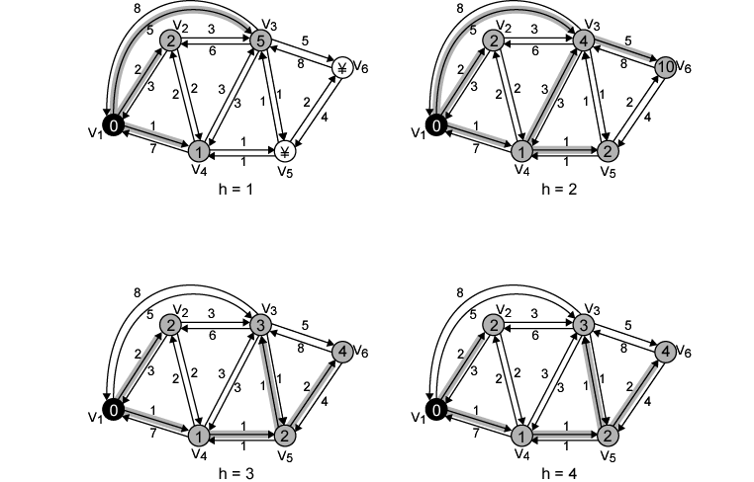
Example of Bellman-Ford Algorithm

Slide 134
Results of Bellman-Ford Example
h | L_{h}(2) | Path | L_{h}(3) | Path | L_{h}(4) | Path | L_{h}(5) | Path | L_{h}(6) | Path
0 | ∞ | - | ∞ | - | ∞ | - | ∞ | - | ∞ | -
1 | 2 | 1-2 | 5 | 1-3 | 1 | 1-4 | ∞ | - | ∞ | -
2 | 2 | 1-2 | 4 | 1-4-3 | 1 | 1-4 | 2 | 1-4-5 | 10 | 1-3-6
3 | 2 | 1-2 | 3 | 1-4-5-3 | 1 | 1-4 | 2 | 1-4-5 | 4 | 1-4-5-6
4 | 2 | 1-2 | 3 | 1-4-5-3 | 1 | 1-4 | 2 | 1-4-5 | 4 | 1-4-5-6

Slide 135
Structure of Routing Table in DV
From V1,
Destination | Hop Count | Nexthop
V2 | 1 | V2
V3 | 3 | V4
V4 | 1 | V4
V5 | 2 | V4
V6 | 3 | V4

Slide 136
Comparison
Results from two algorithms agree
Bellman-Ford => Distance Vector => RIP
    Calculation for node n involves knowledge of link cost to all neighboring nodes plus total cost to each neighbor from s
    Each node can maintain set of costs and paths for every other node
    Can exchange information with direct neighbors
    Can update costs and paths based on information from neighbors and knowledge of link costs
    Good for small network like one campus
    Maximum hop limit of 15.
Dijkstra => Link-state => OSPF
    Each node needs complete topology
    Must know link costs of all links in network
    Must exchange information with all other nodes
    Work well in large network.

